Slide 1

Team 3: Brenda Beltran, Brandon Flores, Jaime Guardado, Sidney Thomas, Banting Lin, Abdarrahman Ayyaz

Slide 2

About Work Waves
Work Waves, is your gateway to flexible gig and side hustle opportunities for anyone with skills to offer.
Has a User generated gig economy which will foster a community of users who share and request to do small jobs for one another.
Notes:
Jaime

Slide 3
Why is Workwaves useful?
Users might only need to get a simple job done I.E. mowing lawn or hiring a pet sitter for the day.
Sometimes finding those people can be through word of mouth, which can be challenging
Quick and easy on the go you find people to fill in short tasks
For Users who want quick work they can
Advertise themselves, i.e. manual labor or babysitter etc.
Look for a quick side hustle to get some cash.
Notes:
Jaime and Banting

Slide 4


Our Competitors
Two of our biggest competitors are craigslist and taskrabbit. These both have different ways of connecting people with work, but they are not designed to get people to work right away.
It could take people days or weeks to get started with their gig.
Notes:
Aman

Slide 5
Demo
We will now present a short demo of our app
https://workwaves-jm2b5.ondigitalocean.app
Notes:
Jaime and sydney(austrailia)

Slide 6
Managing Source Code
VCS - Git, Code style enforced by Eslint. Branch flow new-branch → Develop → Main Coding practices: - ‘Feat’, ‘fix’, or ‘chore’ in branch name. - Commit messages start off with ‘Feat’, ‘fix’, or ‘chore’ as well. - PRs are for draft and work ready to review. They must get tested and approved by another teammate before merging to develop.
Notes:
Brandon

Slide 7
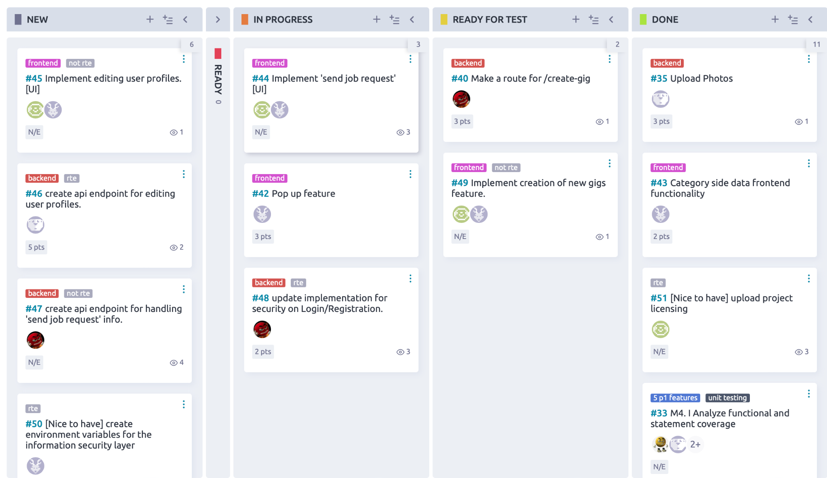

Managing Tasks
We used an open source project management tool Taiga and it’s Kanban board to dictate and control tasks
Notes:
Brandon ITS PUSIERON

Slide 8
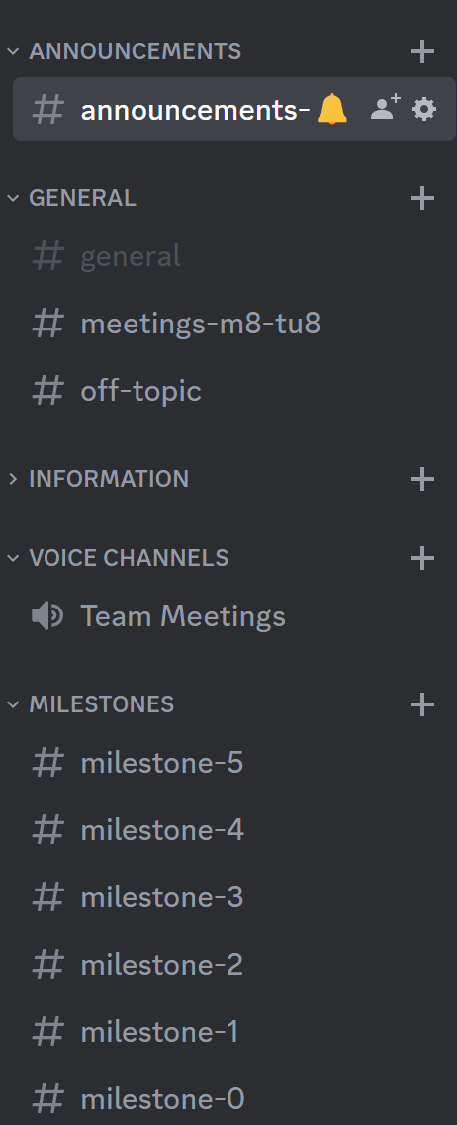
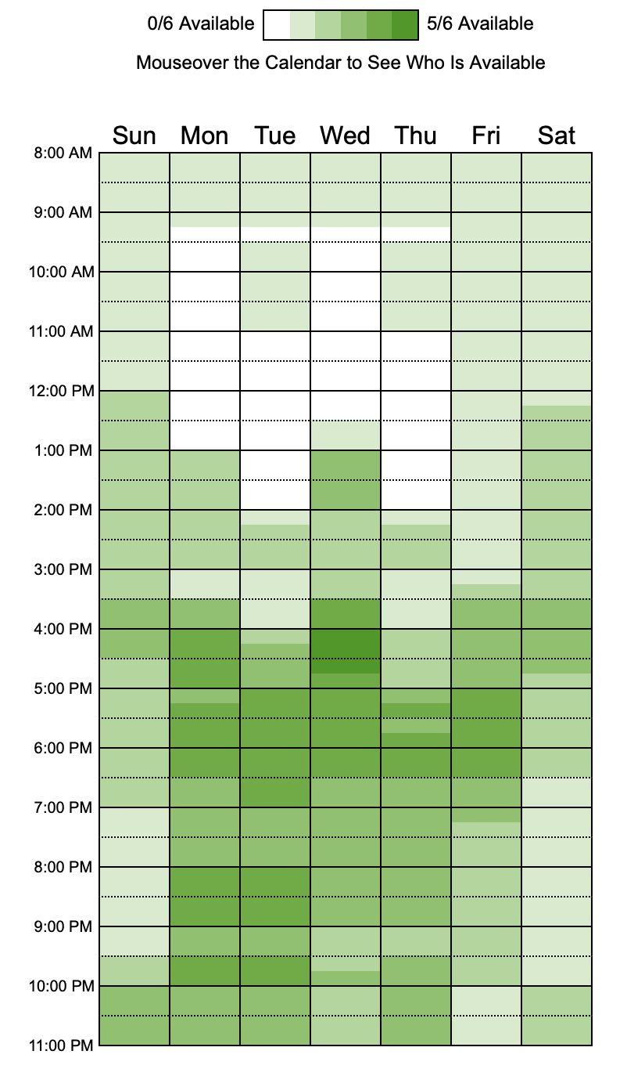
Our Communication
Discord
Our main form of communicating to each other about code, responsibilities, and
When2Meet
User friendly scheduling app that we used to fill out our availability to eventually host meetings.
Zoom
Met weekly with team to go over deadlines and progress.
Notes:
Brenda

Slide 9
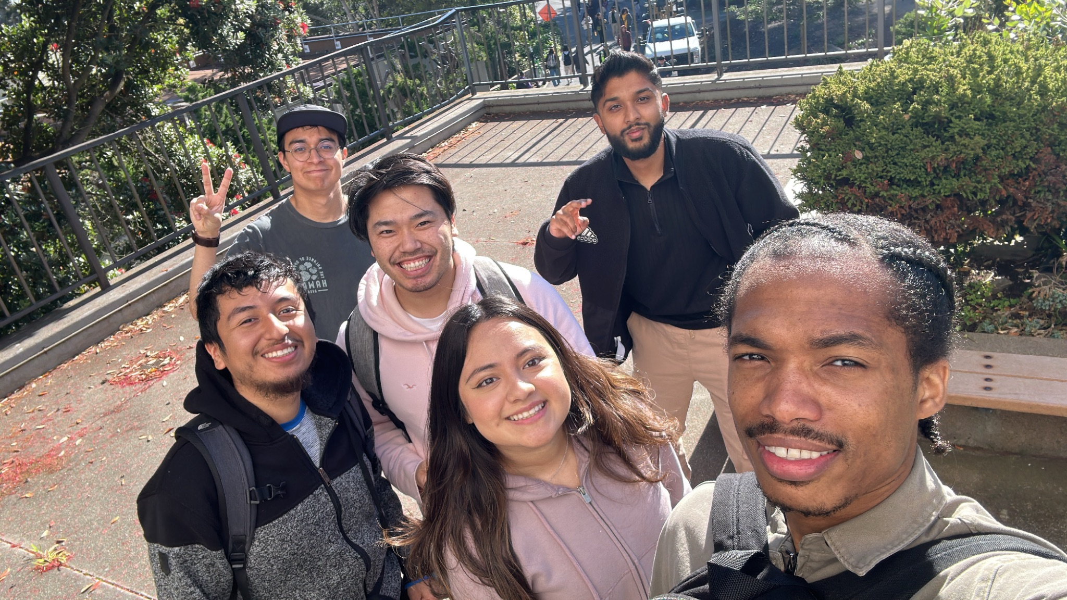
Team Management
Team Lead dictated, organized, and managed the teams progress.
Support would help all other leads and communicate teams needs.
Scrum master helped ensure our documents and all information was collected from every team member
Git Master supported Front End lead
Support supported Back End Lead
Our Meetings would recap our progress and support everyone who needed it
Oh and we bonded over coffee ! <3
Notes:
Brenda

